Slide 1
Safer Gambling Annual Report 2025
March 2026

Slide 2
Foreword
We recognise the significant impact that gambling related harm can have on individuals, families, and communities. As a B2B provider, EveryMatrix operates at the heart of a fast evolving digital entertainment ecosystem. That brings both opportunity and responsibility, and it is why we are committed to upholding the highest standards of player welfare and safer gambling.
This report sets out our Safer Gambling framework and summarises the progress we made across 2025. It reflects our continued focus on strengthening partnerships, embedding safer gambling principles across our products and services, and using technology to support safer play in a practical, measurable way.
We remain committed to continuous improvement, transparency, and collaboration with our customers and stakeholders. For further information, please visit the dedicated Safer Gambling section on our website.

Slide 3
Our Framework
As proud members of the World Lottery Association (‘WLA’) we are committed to maintaining corporate social responsibility standards and a safer gaming framework. The broad categories of commitments and actions that we undertake to foster a safer gambling environment are in line with the WLA framework as follows:
01
02
03
04
COMPLIANCE
A robust framework for evidencing alignment with safer gambling standards and regulatory expectations, supporting client due diligence, audit preparedness, and the effective, responsible delivery of safer gambling measures.
EMPLOYEE PROGRAM
A structured program designed to ensure that all relevant employees are equipped to apply Safer Gambling principles consistently, confidently, and effectively through dedicated training and ongoing support.
CLIENT AWARENESS
Ensuring that clients are well informed about the Safer Gambling features and functionalities of our products and services, so they can communicate these clearly, accurately, and effectively to players.
SAFER BY DESIGN
A proactive and evidence-led approach to ensuring safer gambling considerations are embedded in the design, selection, and introduction of new lottery and gaming products.
05
06
07
08
REMOTE GAMING CHANNELS
A robust framework to ensure that interactive remote gaming platforms are designed and operated with appropriate safeguards that enhance player protection and support safer gambling.
MARKETING AND ADVERTISING
A structured approach to supporting responsible marketing and communications practices, while ensuring alignment with regulatory codes and continuous improvement.
STAKEHOLDER ENGAGEMENT
Ensuring key stakeholders across the company are actively involved in safer gambling decision-making and programme development.
REPORTING AND MEASUREMENT
Ongoing measurement and reporting of the organisation’s safer gambling commitments, actions, and progress to relevant internal and external stakeholders
.

Slide 4
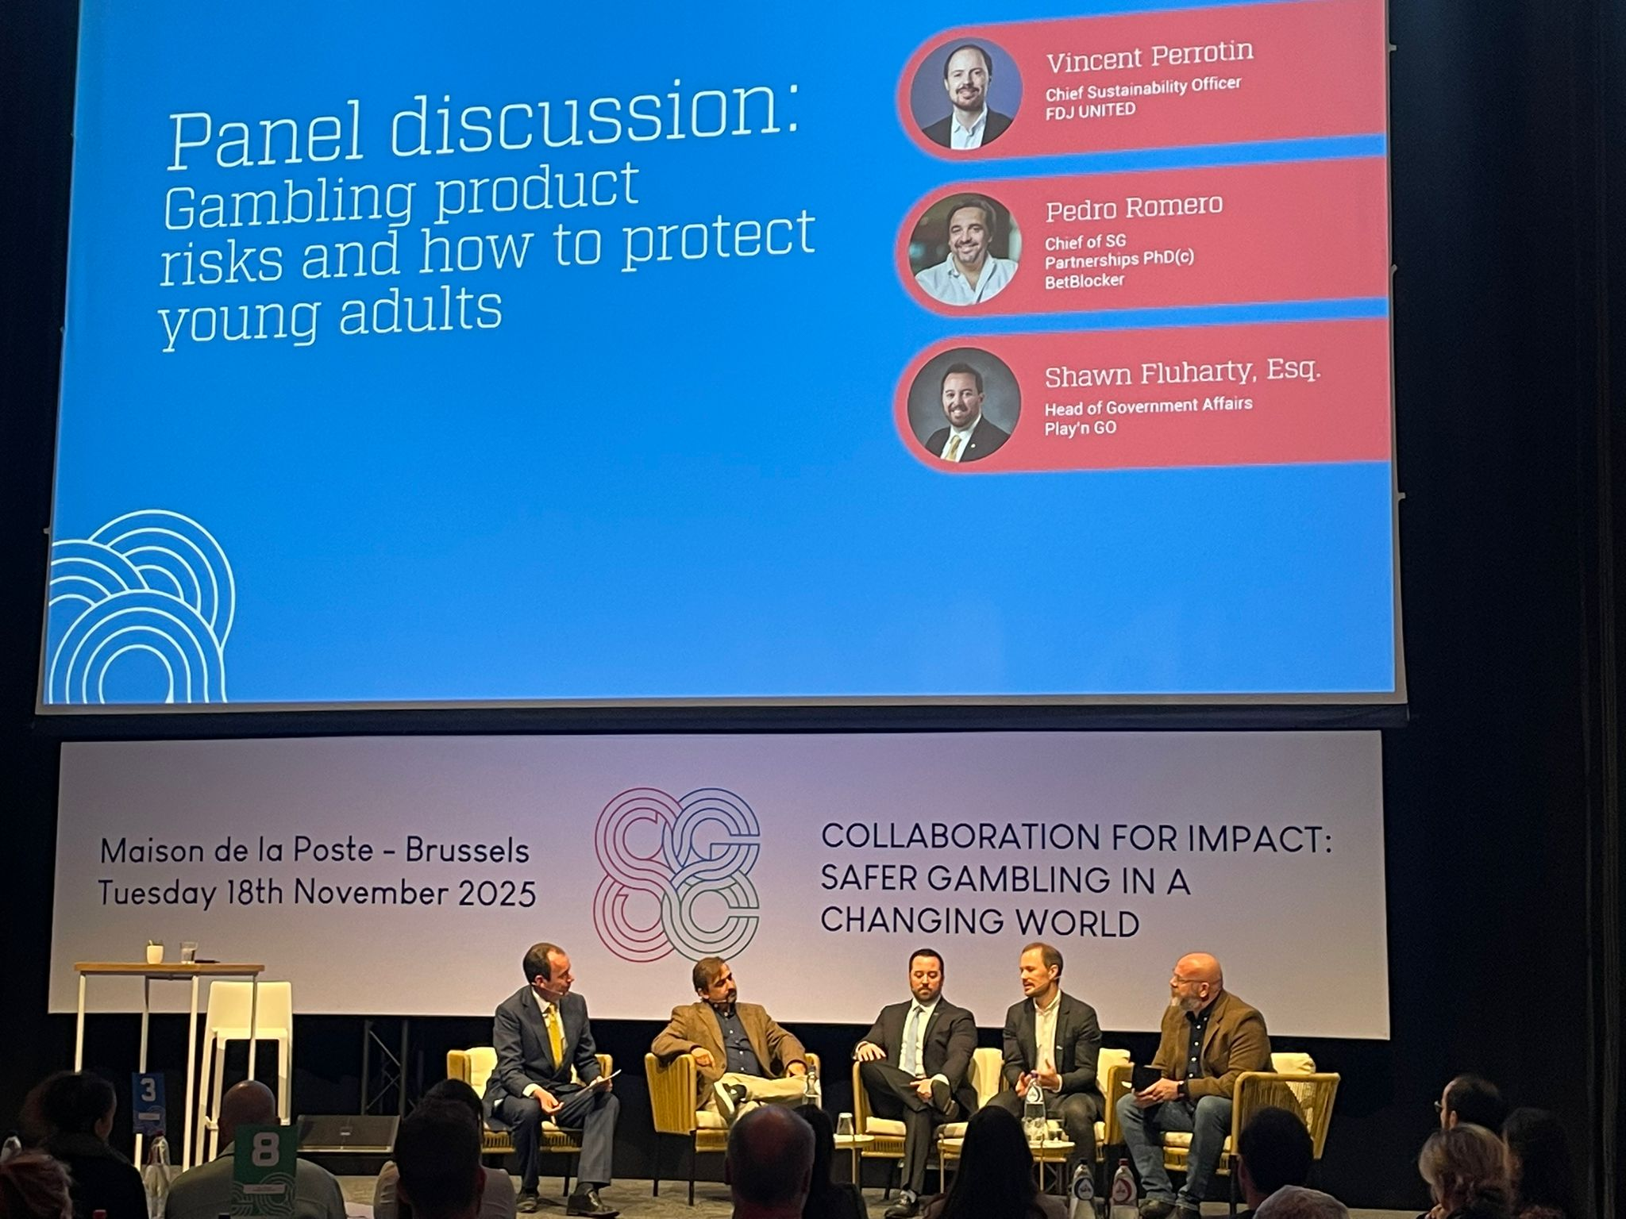

Our Achievements 2025
STRENGTHENED PARTNERSHIPS
Sponsored the localisation of BetBlocker software into Greek, enhancing accessibility for harm minimization tools for players in Greece.
EveryMatrix is licensed believes that supporting accessibility to harm minimisation tools promotes long term sustainability.
INCREASED CHARITABLE CONTRIBUTIONS
Expanded donations by 20% to gambling harm minimization charities, including BetBlocker, to support harm prevention efforts.
NO REGULATORY INTERVENTIONS
No regulatory interventions and achieved 100% compliance with marketing standards.

Slide 5
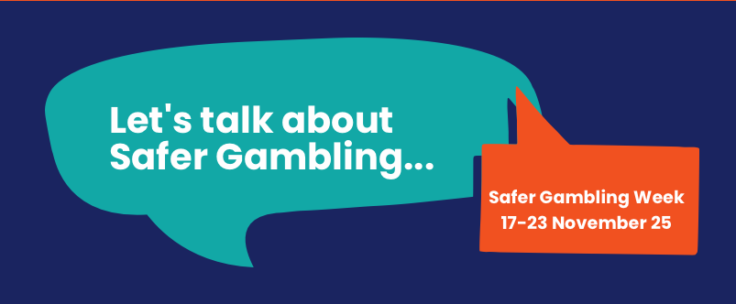
Our Achievements 2025
SAFER GAMBLING WEEK
Participated in Safer Gambling Week through a range of awareness campaigns and initiatives, including videos and an online panel discussion exploring what more B2B companies can do to support safer gambling, as well as ways to protect industry professionals who may be experiencing gambling-related harm.
We also delivered internal activities to engage staff around safer gambling and sustainability. Participation was strong, feedback was positive, and there was clear recognition among employees of the importance of safer gambling.

Slide 6
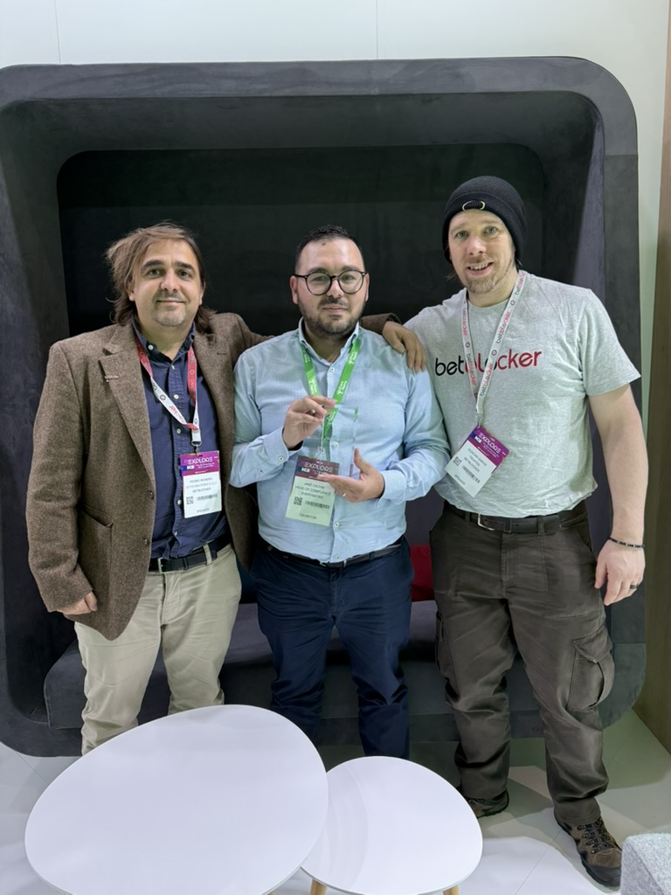
Our Achievements 2025
COLLABORATION
We continue our collaboration with harm minimization organizations and charities.
CERTIFICATIONS
Successfully completed our first internal assessment for WLA certification with positive results, reflecting our commitment to best practices in safer gambling.
INDUSTRY ENGAGEMENT
Actively engaged in multiple safer gambling conferences through panel participation, event contributions, and broader industry discussion, including ICE Barcelona, European Safer Gambling Week, the FDJ Sustainable Gambling Conference, and NEXT New York, among others.
TRAINING
We are committed to safer gambling training. We have developed tailored modules for key departments and, from next year, will introduce annual face to face training for key teams.

